Slide 1
OFDM PAPR Reduction through PTS technique

Slide 2
Table of contents
The PAPR problem in OFDM
Theory
PAPR reduction techniques
The PTS technique
PTS simulations
Incorporation into the OFDM modem

Slide 3
The PAPR problem in OFDM

Slide 4
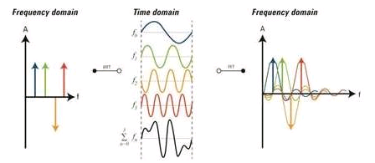
Background- OFDM
The principle: transmission of a signal that is a linear combination of an orthogonal basis
The symbols are the linear combination’s coefficients and are statistically independent:

Slide 5
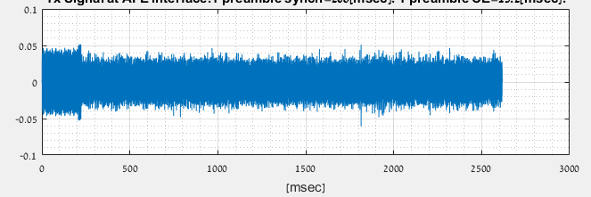
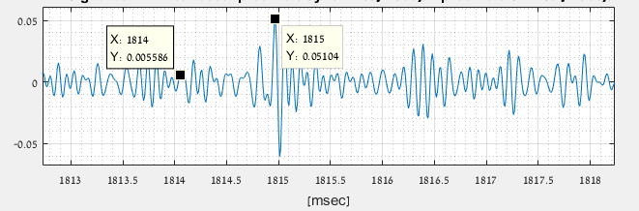
Background- OFDM
Time domain signal:
Typical shape

Slide 6
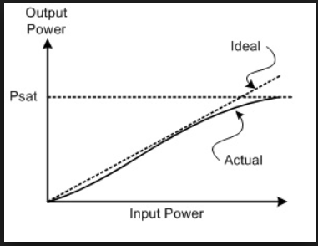
Motivation: PA linearity
PAPR trades-off signal quality Vs. Range and Power consumption
Saturating PA causes:
Distortion
Loss of orthogonality (ICI)
Spectral leakage to adjacent channels
Increasing PA’s compression point increases power consumption
Not saturating nor Increasing: compromise on Pavg, thus on Range

Slide 7
Theory

Slide 8
PAPR definition
For an OFDM block composed of N symbols of duration T seconds;

Slide 9
PAPR distribution (CCDF) [1]
Central limit theorem:
Magnitude is Rayleigh distributed:
Hence;

Slide 10
PAPR distribution (CCDF): analytic expression [1]
Probability of at least 1 sample of time domain signal to cross a certain power level:
if we define , then;

Slide 11
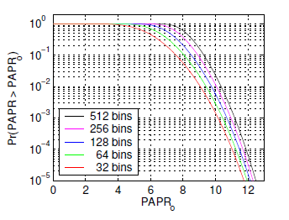
PAPR distribution (CCDF): Theoretical curves[1]

Slide 12
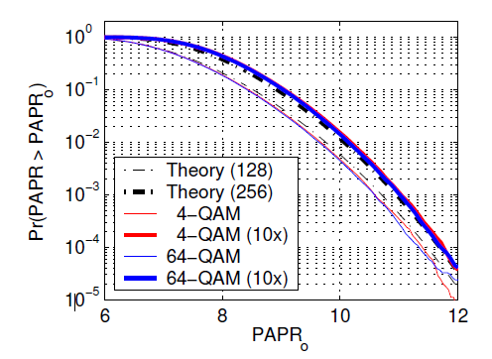
PAPR distribution –Interpolation [1]
Analog signal can be modeled by an interpolated digital signal
Interpolated digital signal has no longer uncorrelated samples
An interpolated N-samples symbol has effectively the non-interpolated theoretical PAPR of a 2N-samples symbol

Slide 13
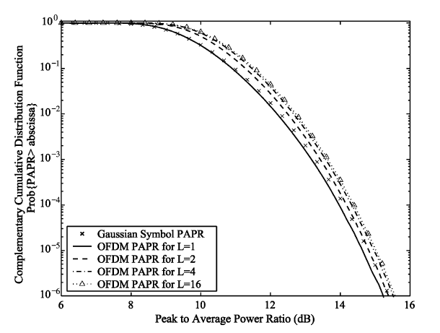
PAPR distribution -Interpolation
The aim of the interpolation is to obtain the signal peaks
The effect of increasing the interpolation factor attains a limit
Typically, a value of L=4 is sufficient

Slide 14
PAPR reduction techniques

Slide 15
Criteria
PAPR reduction
BER performance
Average power conservation
Data Rate
Spectral spillage
Complexity

Slide 16
Techniques comparison
Technique | PAPR Reduction | BER performance | Average power Conservation | Data Rate Loss | Spectral Spillage | Complexity
Clipping | 3dB | Low | Yes | None | Yes | Low
Coding[3] | 3dB | Medium | Yes | Medium | No | Low
Companding [3],[5] | 6dB | Medium | No | None | Yes | Low
Tone Reservation | 3dB | Medium | No | High | No | High
PTS/SLM | 3dB | High | Yes | Medium | No | High

Slide 17
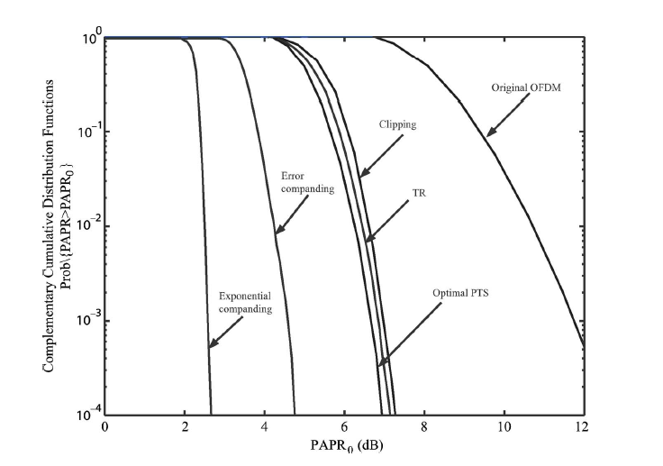
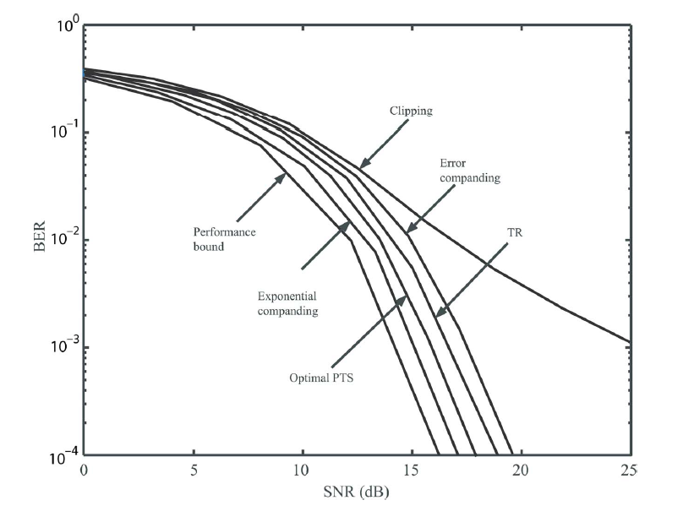
Techniques comparison
PAPR CCDF
BER
Most literature ([4], [5] ,[6] and others) claims the SLM/PTS technique
tradeoffs best the different performance criteria

Slide 18
The Partial Transmit Sequence (PTS) Technique

Slide 19
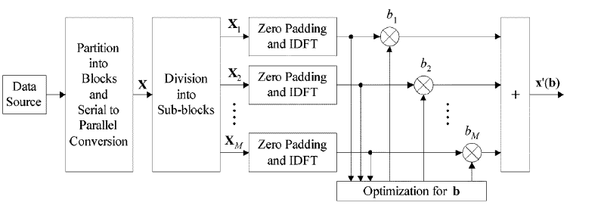
PTS- Block Diagram

Slide 20
Algorithm steps
Division of the N-long OFDM symbol into M sub-blocks:
Contiguous
Polyphase
Zero padding of each of the sub-blocks to length of N
IDFT over each of the sub-blocks
Calculation of optimum PTS coefficients vector:
Iterative flipping
Reduced complexity
Multiplication of the sub-blocks by the PTS coefficients
Summation of the sub-blocks

Slide 21
Mathematical development
Frequency domain OFDM symbol vector form:
Division into M disjoint sub-blocks:
Zero padding of sub-blocks such that:
IDFT execution:

Slide 22
Mathematical development
Multiplication by PTS coefficients:
Summation:

Slide 23
Calculation of PTS coefficients
Optimum PTS: for every symbol, one needs to scan all possible combinations of the M coefficients and all possible values of those coefficients- impractical
In practice:
Number of values limited to W.
Typical values:
W=4
M=8
Typical values of PTS coefficients:
Example:
Sub-optimal low complexity scanning algorithms

Slide 24
Calculation of PTS coefficients- Iterative flipping [7]
b1=1
bm=1 for all m
Compute PAPR. This will be the reference PAPR
Change b2 across all possible W values:
compute PAPR for each value
Keep the value that brought to minimum PAPR as reference
Repeat step 2 for m=3,…,M

Slide 25
Simulation

Slide 26
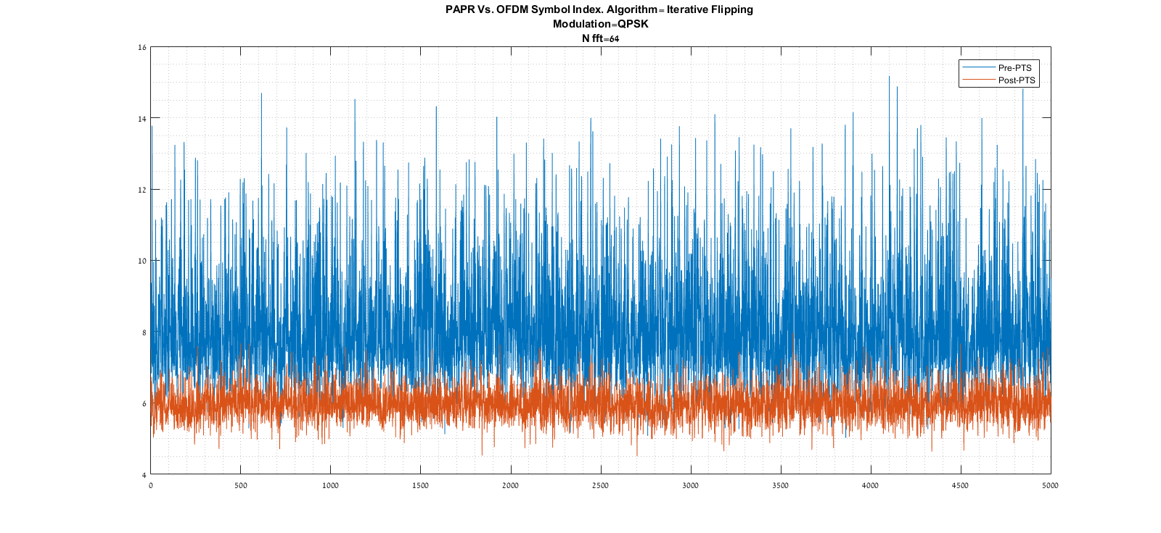
Simulation (time domain)

Slide 27
Simulation (EVM)

Slide 28
Calculation of PTS coefficients- Reduced Complexity [4]
It is to provide very close performance in terms of PAPR reduction wrt the optimum PTS, yet with reduced complexity
Based on gradient descent search algorithm useful in combinatorial optimization problems suggested by Aarts & Lenstra
Principle: Find gradient and optimum step simultaneously, by running over the r-distant b vectors from an initial guess. Repeat that I times

Slide 29
Calculation of PTS coefficients- Reduced Complexity [4]
i=1
b_initial=ones(M,1). b_opt=b_initial
Run over all M-long b vectors r-Hamming away from b_opt, assign all W^r possible values and compute PAPR
Save b_opt; the one bringing to minimum the PAPR
If i<I: Increase i by 1 and return to step 3. else - terminate

Slide 30
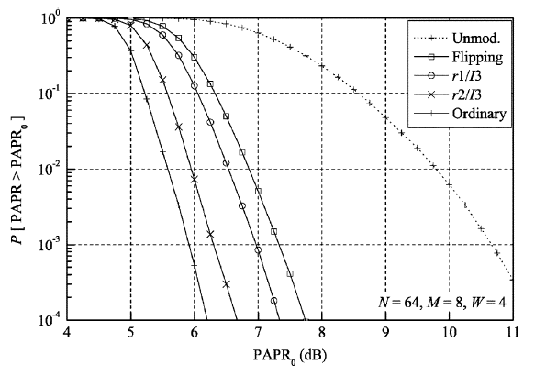
Expected results (vs. unmodulated, vs. ideal)
~1dB
~3dB
Optimum PTS
PTS Reduced complexity
PTS Iterative
Flipping
No PAPR reduction: 10.6dB

Slide 31
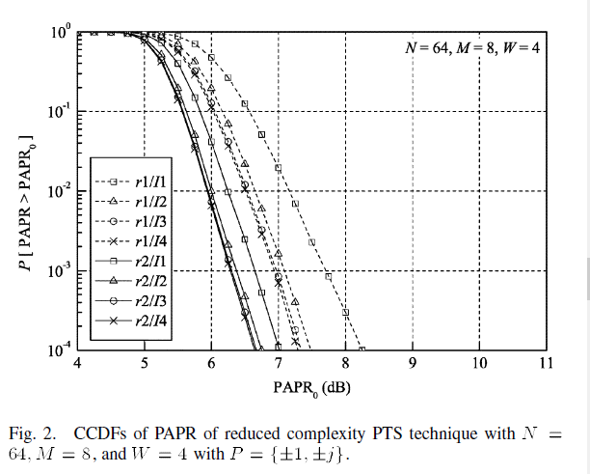
Chosen set of parameters (r,I)
chosen

Slide 32
Simulation Vs. Article
5.95 dB
No PAPR reduction: 10.2dB
6.3 dB

Slide 33
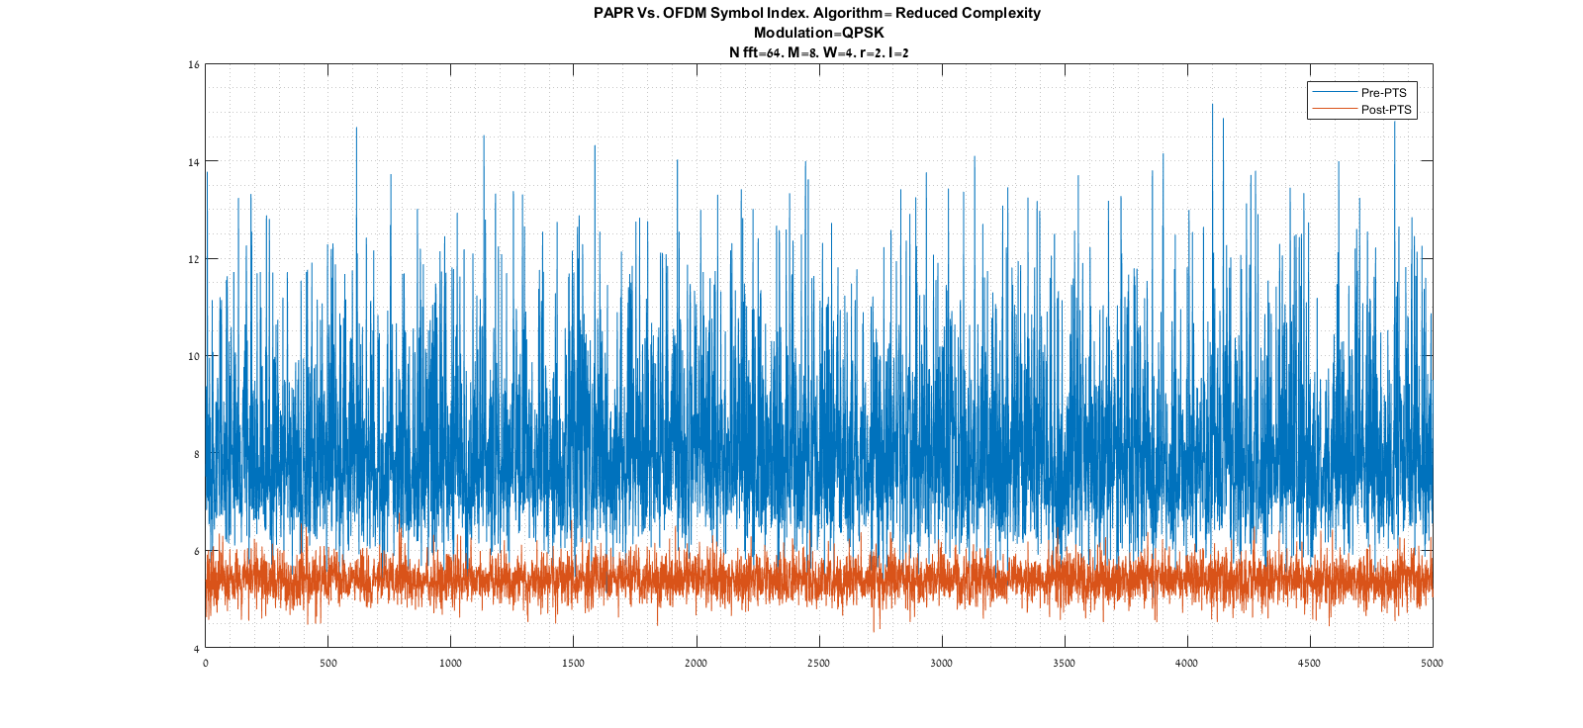
Simulation- time domain
Notes:
The peak power is the absolute one

Slide 34
Calculation of PTS coefficients- Complexity for every OFDM symbol
Iterative flipping algorithm:
Reduced Complexity algorithm: at every i<=I
We run over M-1 choose r different r-Hamming distant b vectors from initial b vector
For every vector, we try W^r different values for the r different terms
Conclusion:
Example: I=1, M=8, W=4, r=2
Reduced complexity: 336 steps
Iterative flipping: 28 steps

Slide 35
Reduced complexity Vs. Iterative flipping
Fits article curves!
~1dB
~3dB

Slide 36
Incorporation into the OFDM modem

Slide 37
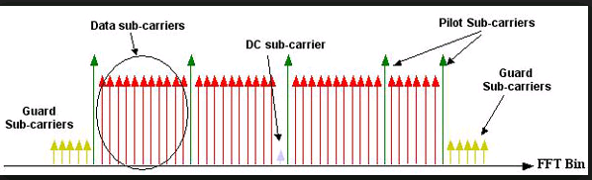
Difference between article and effective signal
Articles simulations refer to an OFDM block fully composed of payload subcarriers: no Guard bands, nor pilots
Actual Block

Slide 38
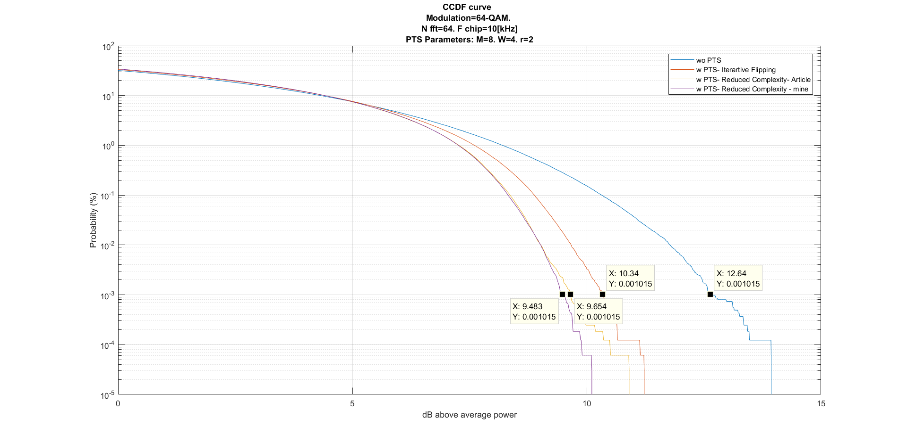
CCDF

Slide 39
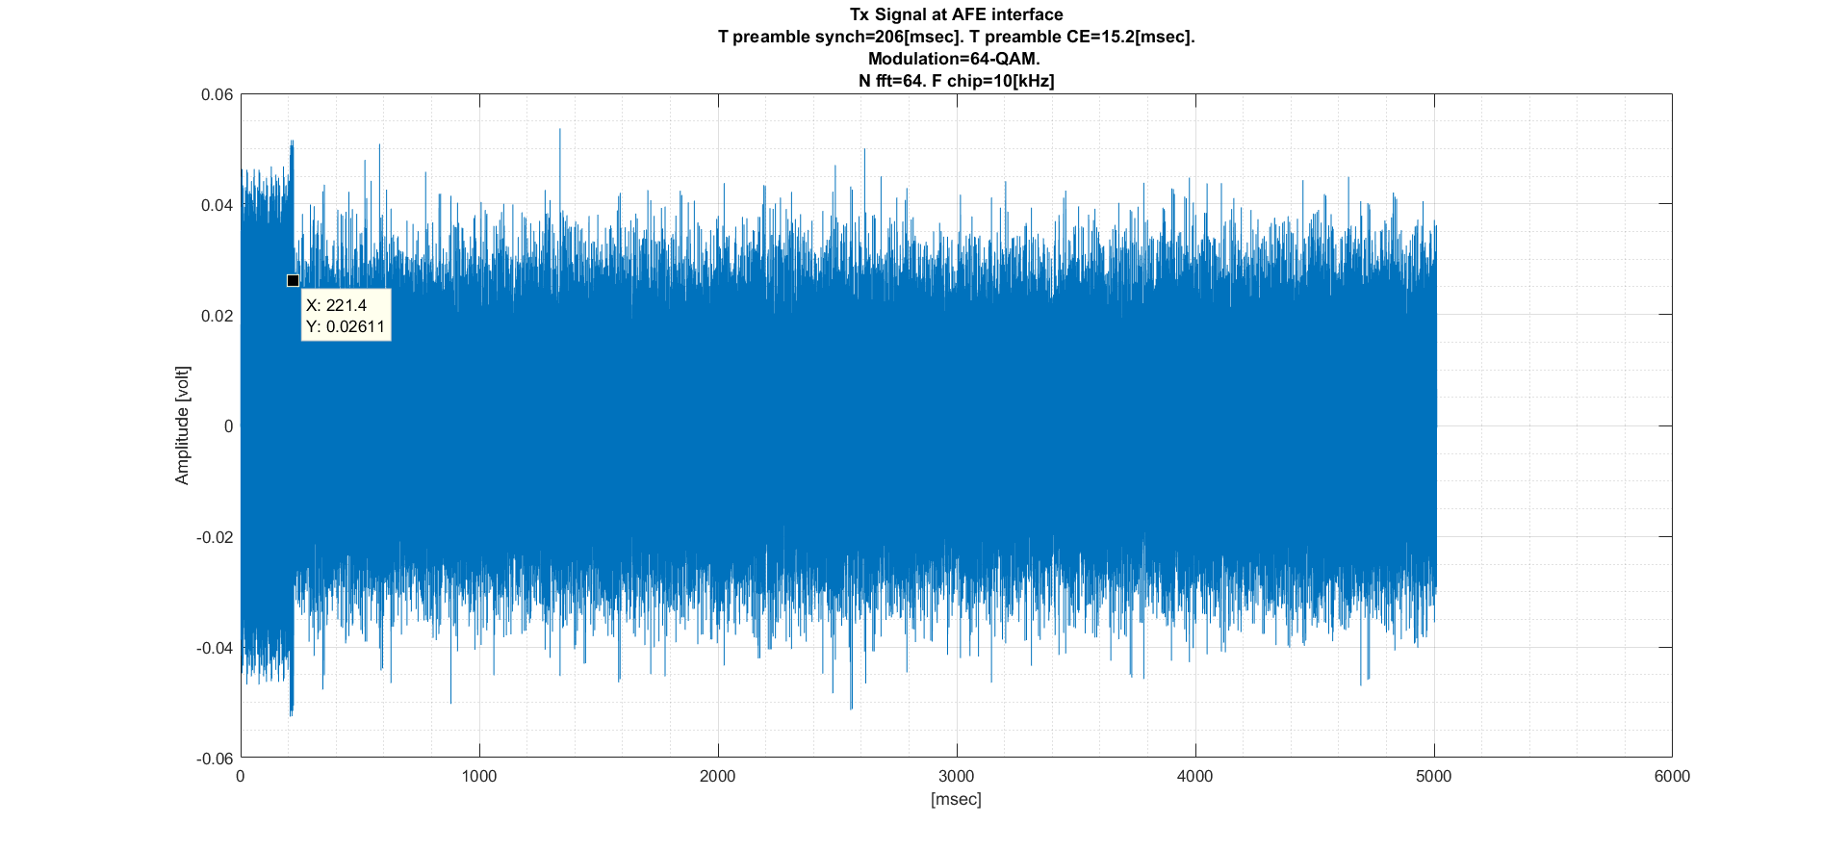
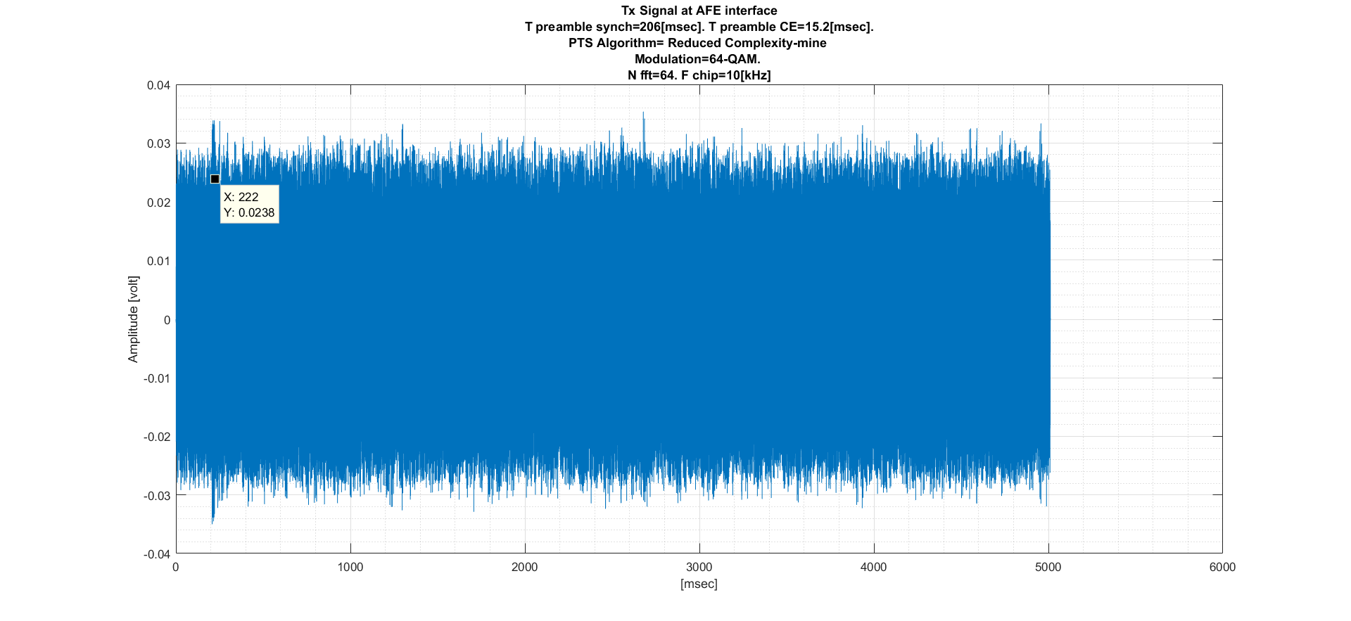
time
preamble
payload
Wo PTS
preamble
payload
W PTS

Slide 40
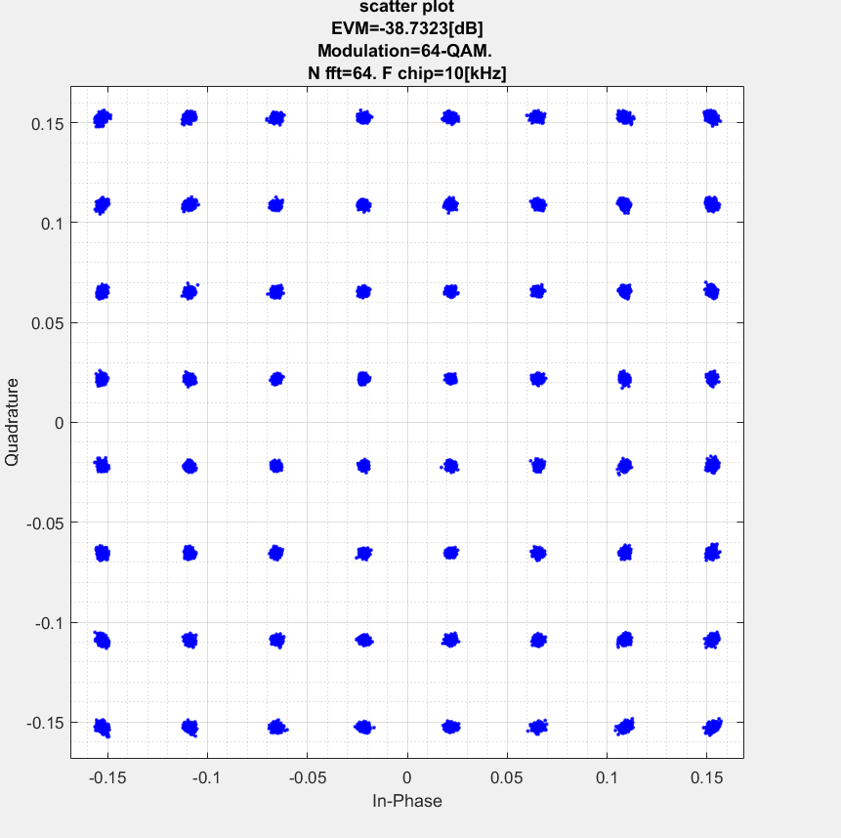
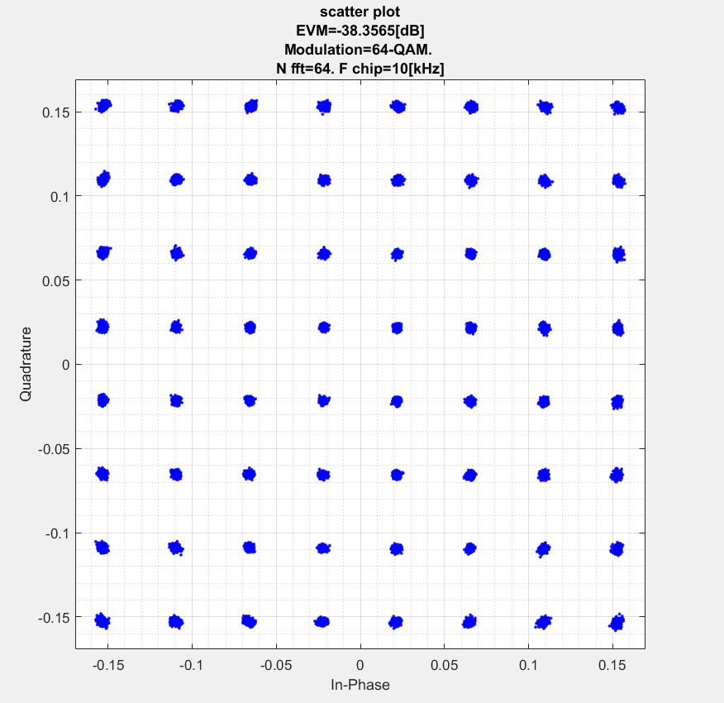
EVM (EsNo=40dB, no multipath)
Wo PTS
W PTS (Reduced complexity)

Slide 41
Block partitioning method
Given the following block:
Contiguous partitioning
Interleaved (“polyphased”): should be better for actual blocks with GB’s- better partitioning of GB’s between sub- blocks

Slide 42
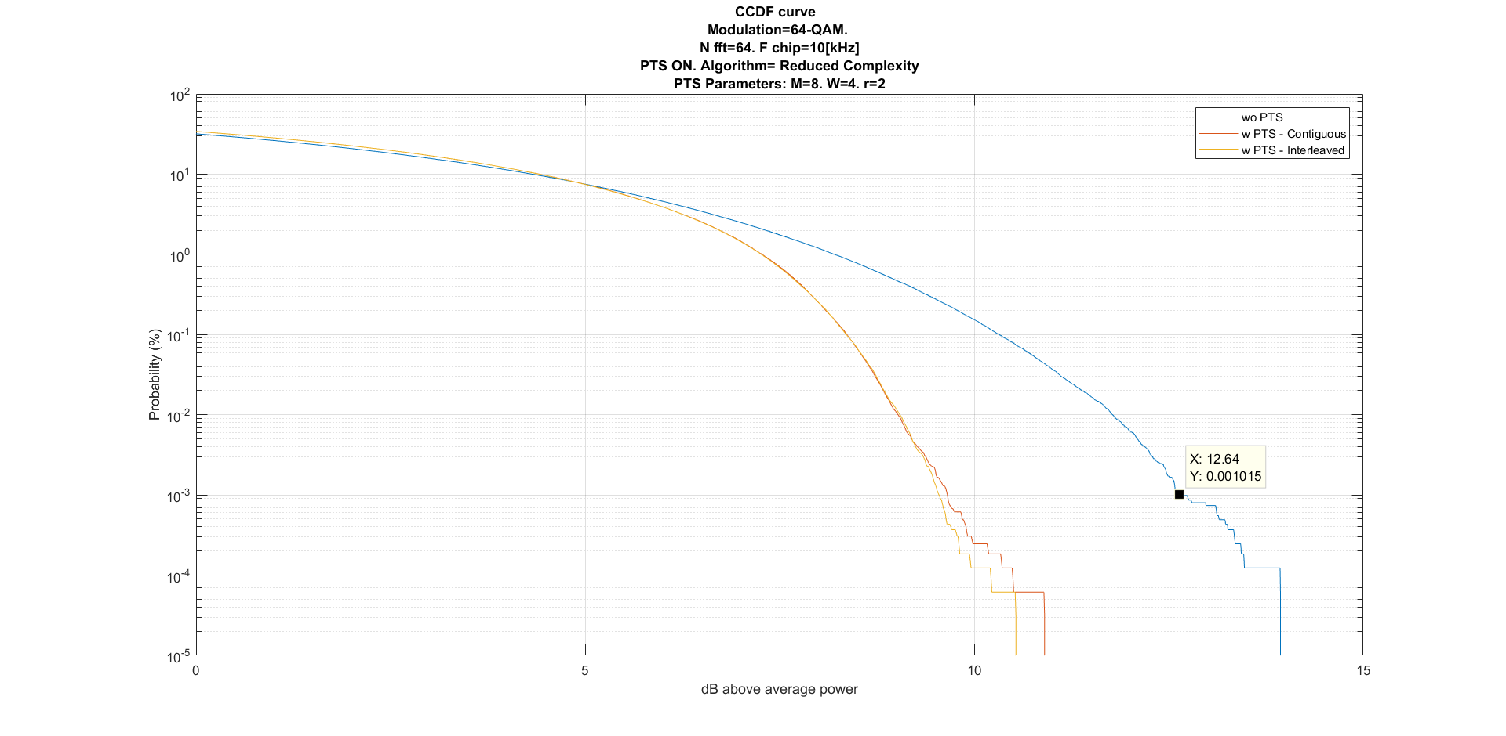
Block partitioning method

Slide 43
References
Circuit-Aware System Design Techniques for Wireless Communication, by Everest Wang Huang
OFDM for wireless communication systems, Prasad
An Overview: Peak-to-Average Power Ratio Reduction Techniques for OFDM Signals, Jiang& Wu
PAPR Reduction of OFDM Signals Using a Reduced Complexity PTS Technique, Hee Han & Hong Lee
peak to average power ration in OFDM, Chapter 3. Shodhganga
PAPR Reduction Techniques for OFDM Systems, P.Kalaivani, ,S.R.Balasubramanian,
Peak to average power ratio reduction of an OFDM signal using PTS, Cimini, Solenberger

